Slide 1
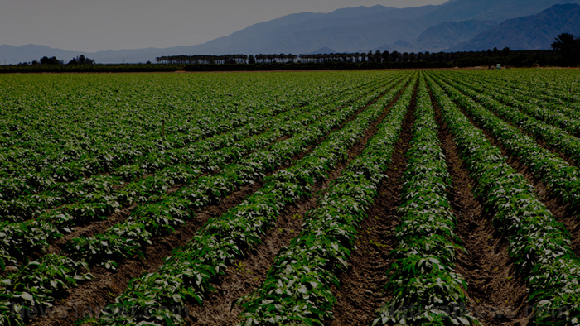

MONSANTO
A plan for a Globalizing Future

Slide 2
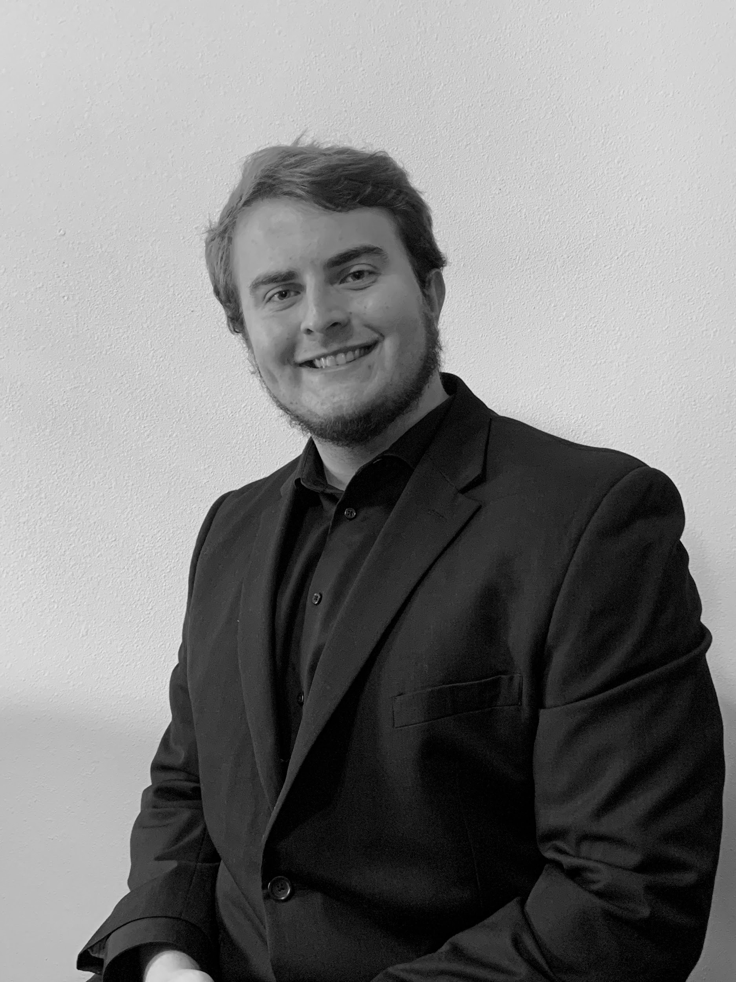
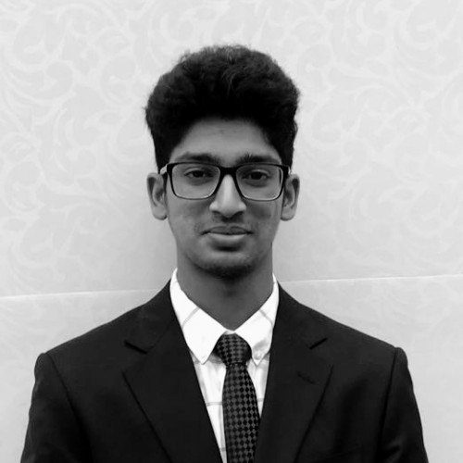



Our Team
ZACHARY EAVES
JAYANTH AKULA
JOSHUA STUEBE
BROCK STUDER
SEAS Consulting
Introduction | Executive Analysis | Strategy | Financials | Conclusion

Slide 3
Assumptions
Demand for Monsanto Fund will be at the same level with, or higher than by which we are increasing capital
Consistent advancement in the technology associated with the bio-agri-tech industry
Global Demand increase at 3-5% increment annually
Introduction | Executive Analysis | Strategy | Financials | Conclusion
Notes:
Demand for Monsanto Fund will be at the same level with, or higher than by which we are increasing capital in the fund by [steady increase in the demand for STEM: hence increase funding]
Global demand for fertilizers and agricultural products increases consistently at 3-5% annually
Consistent advancement in the tech that helps to ag/bio industry

Slide 4
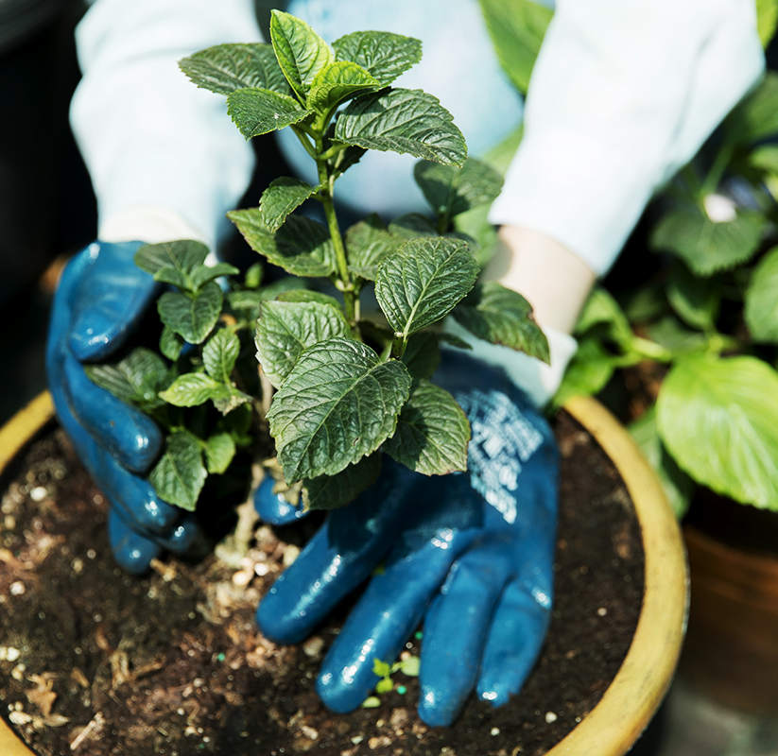

SEAS Goal:
“We understand the crucial role (biotechnology) agriculture has in feeding the world while utilizing the least amount of resources possible. We are committed to helping farmers grow more food using fewer resources and together, we have made meaningful progress against our goal of advancing modern agriculture,”
Pam Strifler, Vice President, Global Sustainability Team
Introduction | Executive Analysis | Strategy | Financials | Conclusion
Recommendations | Findings| Implementation | Implementation Timeline | Risk | Strategy Impact

Slide 5
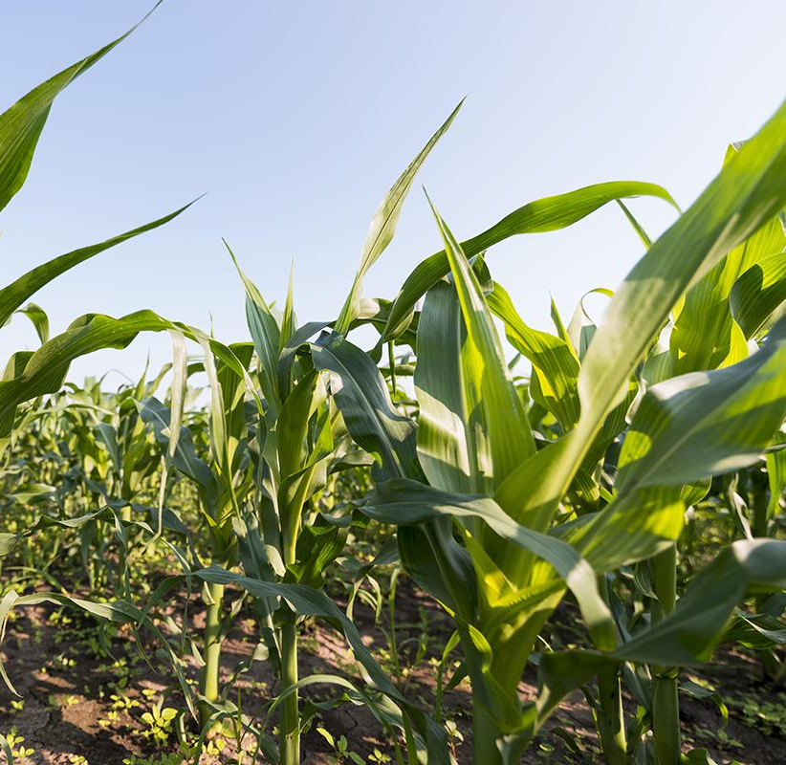
PROBLEM VS. SOLUTION
Balance the Positive Marketing of our Goods against possible negative externalities of GMO’s
Introduction | Executive Analysis | Strategy | Financials | Conclusion
Notes:
Balance the Positive Marketing our Goods against possible negative externalities of GMO’s

Slide 6
We need to improve the consumer perception about GMO benefits, and improve the product adoption rate in potential markets
Strategies
Impact
Marketing
STEM Education
Improve Brand Image
Increase in Monsanto Fund of 3.5 Million Per Year
Increase in adaptation by 20-30%
Introduction | Executive Analysis | Strategy | Financials | Conclusion
Notes:
Impact:
Improved brand image
Increase in ROI
Increase in NI

Slide 7


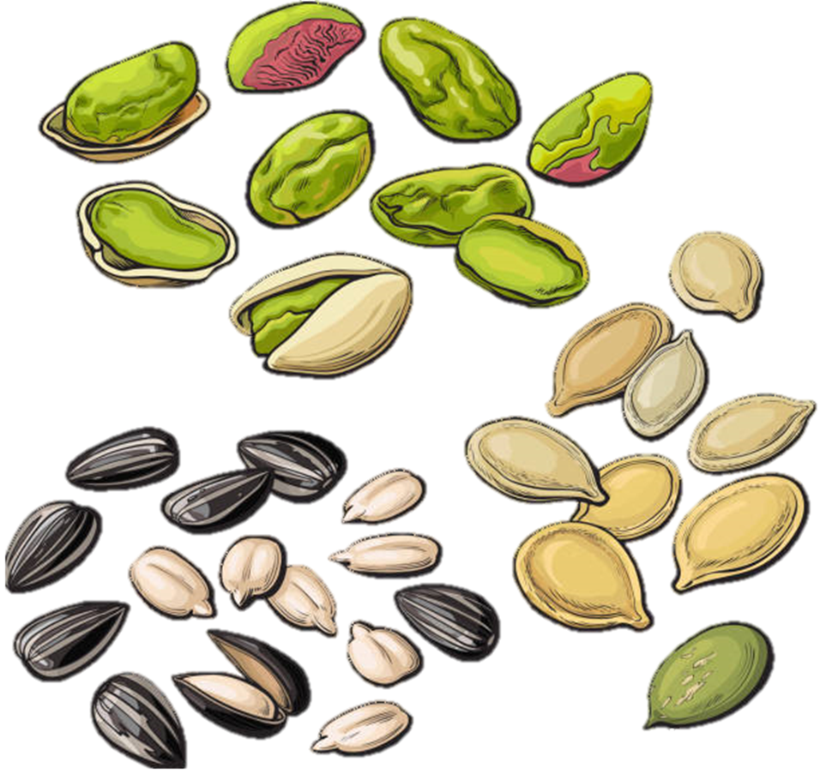

Monsanto Stakeholder Cycle
Farmers
Monsanto
Local NGO
US government
Local Government
Introduction | Executive Analysis | Strategy | Financials | Conclusion

Slide 8

Marketing Segmentation
Market Size
Availability of Land
Climatic conditions
Resources
India
Brazil
Poland
Market Potential
Customer base
Possible testing grounds
Openness to experimenting with GMOS
Connections to other potential markets
Japan
Introduction | Executive Analysis | Strategy | Financials | Conclusion

Slide 9




Countries of Interest
01
India - Largest Potential Market
02
Brazil - Great Crop Diversity
Poland
Japan
03
04
Currently GM Cotton Only
Serious potential for shifting opinions
Climate zones
Potential testing grounds for new crop variations
Entrance into the EU market
Great cultural diversity
Readily open to accepting to GMO
Great workforce
Introduction | Executive Analysis | Strategy | Financials | Conclusion
Notes:
The scale and return on investment that Gmo seed agriculture has needs to be organized in a hierarchical fashion. Not every single country is in the same developmental and adoption stages. Some countries do not like as much foriegn interference

Slide 10
Monsanto Fund
$7 million
$24.5 million
Accumulated capital into the Fund from 1994 to 2001
Increase per grant funding from $10k and $25 to $20k and 40k
Total capital in the Fund by the end of year 5, $17.5 million increase
Introduction | Executive Analysis | Strategy | Financials | Conclusion
Notes:
Objective - Improve lives in farming communities around the world, as well as supporting the communities in which Monsanto employees live and work.
Providing basic education support designed to improve education in farming communities around the world, including supporting schools, libraries, science centers, farmer training programs and academic programs that enrich or supplement school programs.
Meeting critical needs in communities by supporting non-profit organizations that help with things such as food security, sanitation, access to clean water, public safety and various other local needs.
Grow Rural Education is who approves the grant, the Monsanto Fund is who funds the grant.
From 2011 to 2017, more than $14 million was awarded to over 900 school districts to enhance their STEM education. In 2018, $2.3 million was awarded.
Types of projects funded by Grow Rural Education:
New or upgraded technology for hands-on learning
Greenhouses and outdoor learning environments
Teacher and curriculum development
STEM related projects
Applications to the Monsanto Fund for international regions is by invitation only.
Minimize negativities towards the brand and maximize interest in monsanto through
America’s Farmers Grow Rural Education.
Bayer fund grants are 5k- grants are applied for by school, school can use the funds to develop interest in STEM from a CSR perspective in order to one 1 justify our own future business with the country, and 2 more importantly
Through the Monsanto Fund, we will foster a generation of pro GMO farmers which will foster the acceptance of GMOs worldwide

Slide 11
Timeline - Market Segmentation
YEAR 1
YEAR 2
YEAR 3
YEAR 4
YEAR 5
SURVEY FARMERS
IMPLEMENT MARKETING PLAN
REVIEW PRODUCT SUCCESS
ENSURE ADOPTION RATE GROWTH
CUSTOMER REVIEWS AND SURVEYS
Survey farmers to gauge interest and openness to GMOs
Implement plan into India, Brazil, Poland, and Japan markets
Communicate with farmers to ensure products are successful
Expect an adoption rate increase of ~5% to 8% per year
Access the success rate, impact, and improvements of graduating classes
Introduction | Executive Analysis | Strategy | Financials | Conclusion

Slide 12
Timeline - Monsanto Fund
YEAR 1
YEAR 2
YEAR 3
YEAR 4
YEAR 5
REVIEW APPLICATIONS
APPROVE AND RELEASE GRANTS
APPROVE AND RELEASE GRANTS
APPROVE AND RELEASE GRANTS
ASSESS USE OF GRANTS
Filter out risky applications while deciding which are to be approved
Give funds to approved school districts
Give funds to approved school districts
Give funds to approved school districts
Access the success rate, impact, and improvements of graduating classes
Introduction | Executive Analysis | Strategy | Financials | Conclusion
Notes:
Already have BT Cotton product established in India (85% adoption rate by 2009). Can use the success of this product to promote the establishment of new products into the India market.
What specific product do we want to establish in India?
Year 1 -
Year 2 -
Year 3 -
Year 4-
Year 5-

Slide 13

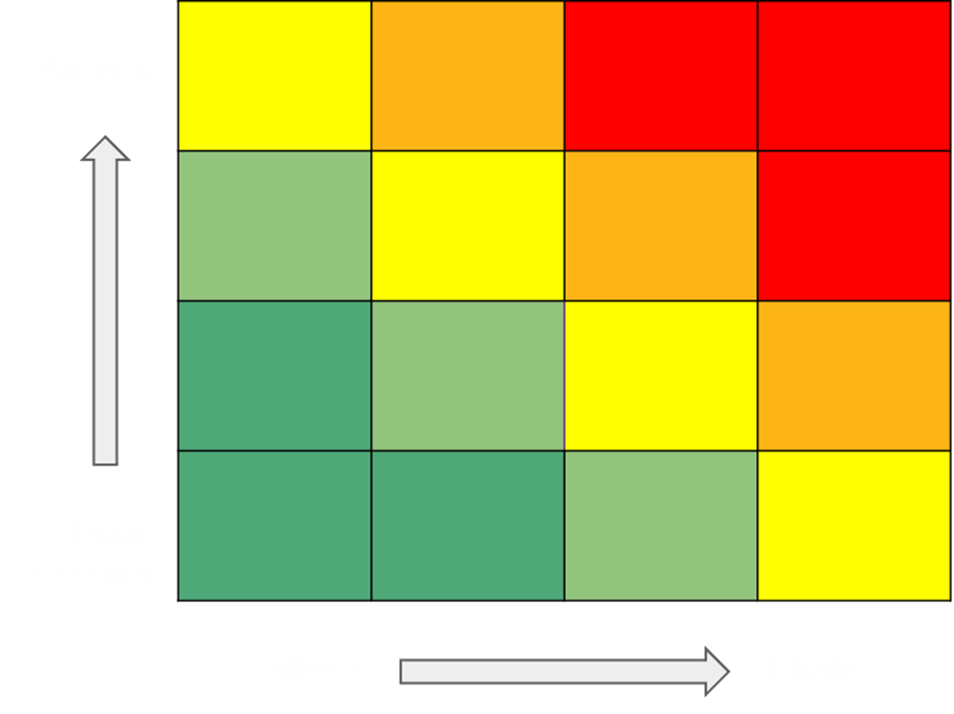


Risks
Possible cross-pollination
R&D investment
Positive CSR image not obtained by stakeholders
Marketing through STEM course
Specific products not accepted by markets small farmers
Survey in year one to find which Indian markets are open to GMO
Introduction | Executive Analysis | Strategy | Financials | Conclusion
Notes:
First recommendation (Market Segmentation) -
Risk: Cross-pollination…. Risk Mitigation: R&D investment
Farmers replant seeds
:
Second recommendation - (Monsanto Fund) -
Risk: Positive CSR image is not obtained by stakeholders…..Risk Mitigation: Marketing the success of the Monsanto Fund with the schools
Third Recommendation -
Risk: Indian market tech adoption/lack of infrastructure…..Risk mitigation: Indian govt prioritizing infrastructure improvement
Risking Brand Image by forcing new product in a new market
Mitigation:Long marketing stretch involving wide reach, and language translated marketing for better understanding of GMO and our products to our customers

Slide 14
Risks Mitigations
Possible cross-pollination
R&D investment
Positive CSR image not obtained by stakeholders
Marketing through STEM course
Specific products not accepted by India’s small farmers
Survey in year one to find which Indian markets are open to GMO
Introduction | Executive Analysis | Strategy | Financials | Conclusion

Slide 15
Key Performance Indicators
Increase adoption rate by 30% year 1, +20% every successive year
Increase in STEM enrollment by at least 50% by year 3
Customer Reviews and Surveys
Introduction | Executive Analysis | Strategy | Financials | Conclusion

Slide 16
Financial KPI
Positive Cash Balance in year 2005
$400,000 for each country’s NGO Creative Budget
50% increase in Total Overall Employees Overseas by year 4
Introduction | Executive Analysis | Strategy | Financials | Conclusion

Slide 17
Summary
Solutions
Marketing
STEM Education
Impact
Improved brand image
Increase in Monsanto Fund to $24.5mil
Increase adoption rate by 20-30%
Introduction | Executive Analysis | Strategy | Financials | Conclusion

Slide 18
Appendix
Title Slides
Our Team
Assumptions
SEAS Goal
Problem vs Solution
Strategy
Shareholder Cycle
Market Segmentation
Countries of Interest
Monsanto Fund
Timeline - Market Segmentation
Timeline - Monsanto Fund
Risks
Risk Mitigations
Key Performance Indicators
Financial KPIs
Summary
Appendix
India SWOT Analysis
Brazil SWOT Analysis
Poland SWOT Analysis
Japan SWOT Analysis
Indian Country Markets
Culture and Diversity
Monsanto Fund Explanation
Countries Banning GMOs
Population Problem
The Solution
29. Brazilian Water Crisis
30. Deforestation in Brazil
31. VP Quote
32. Adoption of Bt Cotton in India
33. Monsanto Smallholder Program
34. Poland/EU on GMOs
35. Industry Performance
36. Key External Drivers (1)
37. Key External Drivers (2)
38. Major Competitors
39. Indian Gov’t on Agritech
40. Demographic of Rice Farmers in India
41. India Rice Production Graph
42. Example of Marketing
43. Key Factors in New Markets
44. STEM Grant Details
45. Grow Rural Education Program
46. Feud with EU
47. Purchase of Delta Pine
48. Marketing Budget
49. Cash Flows Statement
50. USD to Rupee Conversion
51. Income Statement
| Appendix |

Slide 19
SWOT Analysis India
Strength:
15 agro climatic zones
Agriculture experience
Cost effective labor
Weakness
Cultural constraints
Variable climate: constraint type of crops
Lack of land due to population
Opportunity
Cost efficient products
Good testing ground due to diverse market segments
Good R&D material available
Threats
Primary Competitor:
Local laws and regulation
Lack of marketing reach
Possibly destroy ecosystem
| Appendix |

Slide 20
SWOT Analysis Brazil
Strength:
Readily available resources
Good climatic conditions
Acceptance of GMO
Weakness
Pesticide resistance
Opportunity
More R&D possibilities due to availability of resources(both material and climatic)
Threats
Local regulation
Consumer perceptions
Local Crimes
| Appendix |
Notes:
Main thing we want to drive home is there, there key benefits that can be realized by international researches on the benefits gmo products might products, we should

Slide 21
SWOT Analysis: Poland
STRENGTHS
WEAKNESSES
OPPORTUNITY
THREATS
Culturally rich, and strong economy.
EU Backing
S
W
Labor Market regulations, lacking in tech advancement
Tech advancement
Potential for the rest of the EU to follow along GMO
O
T
Labor Regulations, EU policies, lack of advancement flexibility
| Appendix |

Slide 22
SWOT Analysis: Japan
STRENGTHS
WEAKNESSES
OPPORTUNITY
THREATS
Good management practises, education system, responsible and hardworking personnel
S
W
Environmental Disasters, low birth rate, older workforce by age distri.
Tech advancement, better testing grounds for GMO products
O
T
Taxes, trade regulation, economic recession
| Appendix |

Slide 23
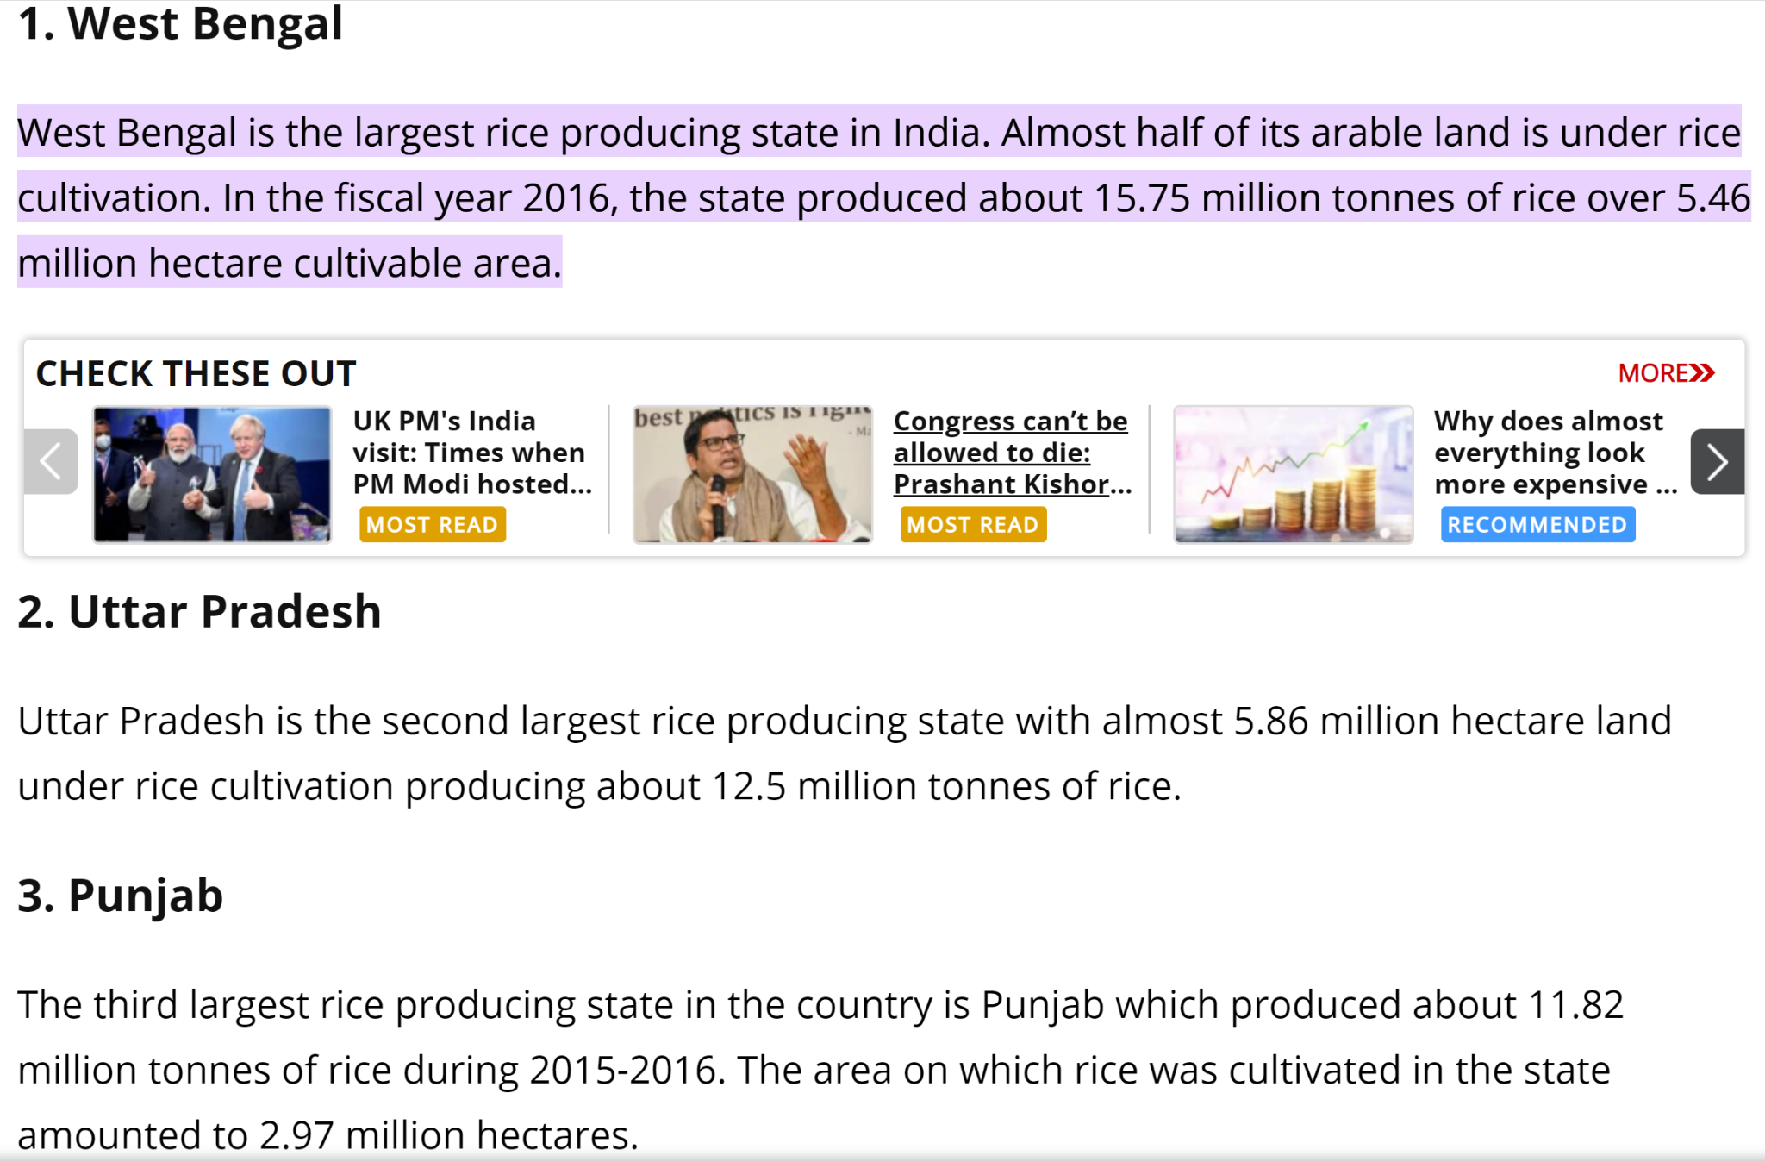
https://www.indiatoday.in/education-today/gk-current-affairs/story/top-10-rice-producing-states-in-india-rice-production-and-area-under-cultivation-1343024-2018-09-18
| Appendix |

Slide 24
International Culture and Diversity
 | OVERALL CULTURE SCORE | GENDER SCORE | DIVERSITY SCORE
MONSANTO | 1st | 1st | 1st
DOW CHEMICAL | 5th | 5th | 4th
DUPONT | 6th | 4th | 3rd
| Appendix |
Notes:
Within the bio tech industry

Slide 25
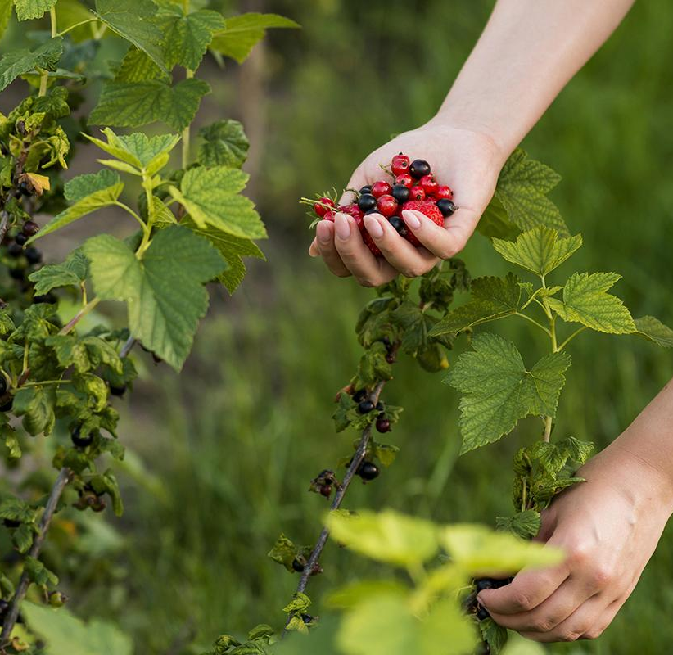
Monsanto Fund
Help deliver the Message
SATURN
Venus is the second planet from the Sun
Saturn is a gas giant and has several rings
| Appendix |
Notes:
We need a graphic on this slide which readers can use to visualize the benefits to main consumer

Slide 26
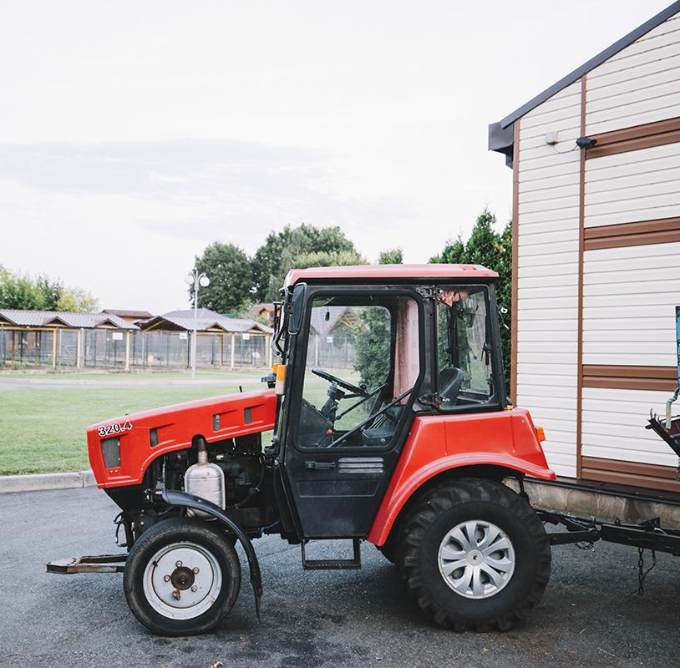
Countries which have fully or partially banned GMO Goods
60
| Appendix |
Notes:
Create nice visualiz

Slide 27
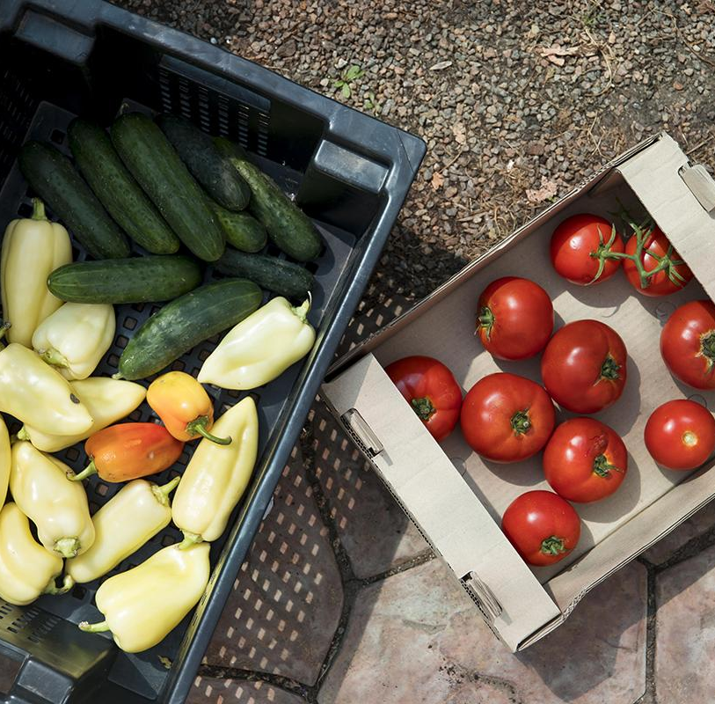
THE PROBLEM
The world population will increase by 2030, which will mean more than 1.2 people to be fed
| Appendix |

Slide 28

THE SOLUTION
Management with the union of farmers, agricultural crop scientists and technology professionals
| Appendix |

Slide 29
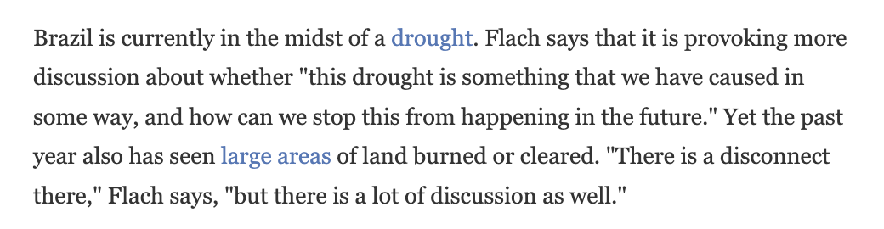
https://www.npr.org/2021/07/13/1015373344/why-clearing-brazils-forests-for-farming-can-make-it-harder-to-grow-crops
| Appendix |

Slide 30
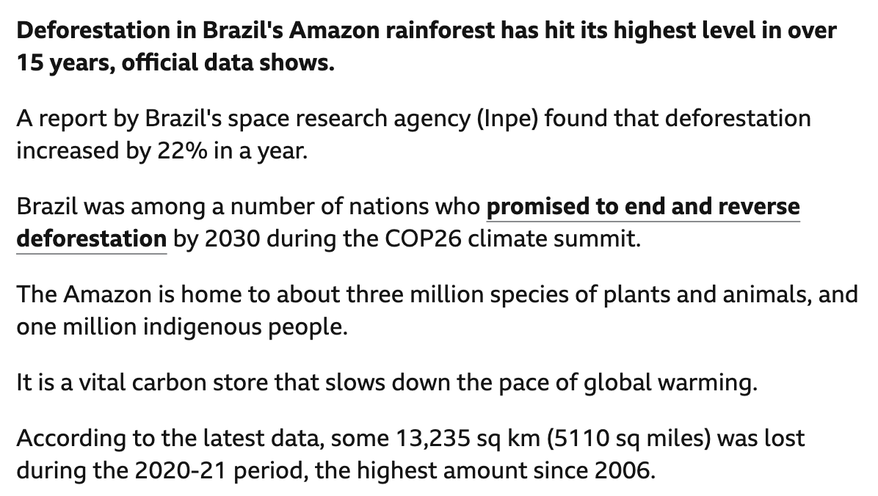
https://www.bbc.com/news/world-latin-america-59341770
| Appendix |

Slide 31
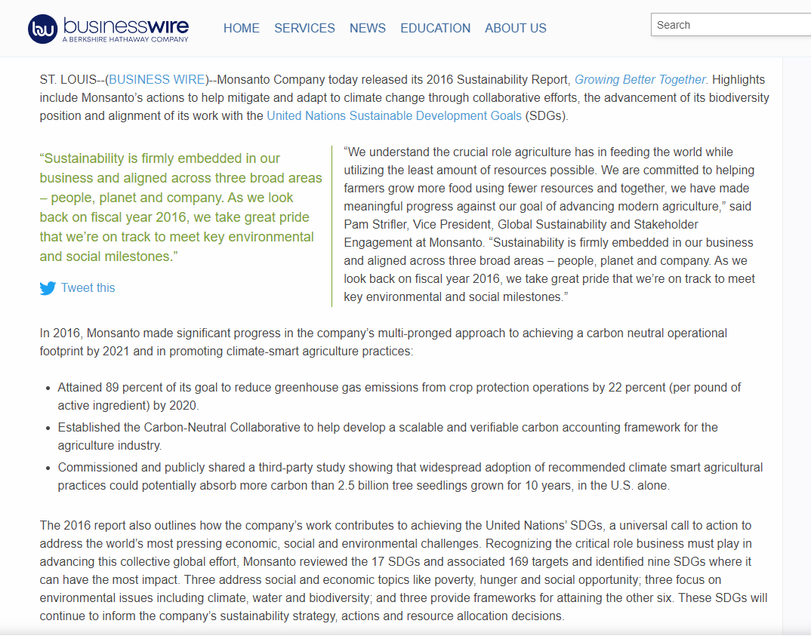
https://www.businesswire.com/news/home/20170221005418/en/Monsanto-Marks-Substantial-Progress-against-Sustainability-Goals-in-2016-Report
| Appendix |

Slide 32
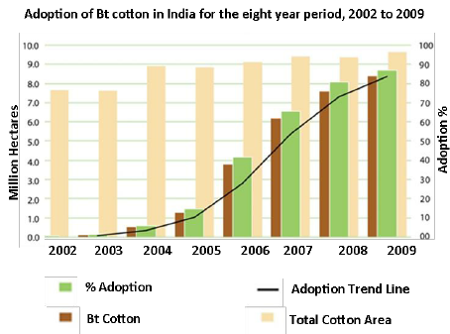
https://www.researchgate.net/figure/Adoption-of-Bt-cotton-in-India-for-the-eight-year-period-2002-to-2009-Choudhary-Gaur_fig1_282855778
Starting the product from scratch, having only an R&D team and an idea is a tough challenge. On the path of your product, you will need to raise funds
| Appendix |

Slide 33
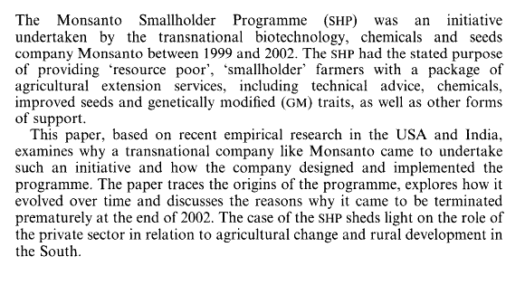
https://www.jstor.org/stable/20454965?saml_data=eyJzYW1sVG9rZW4iOiIwMzk4Y2I5Yi1lNzk4LTRhMTYtYWYzZi1hYzJjZTYzZWZlNjAiLCJpbnN0aXR1dGlvbklkcyI6WyI3YmRlODIyNC04OTQzLTQwY2MtYjA1YS0xZDE3ZjI5NjEzYTIiXX0&seq=1
| Appendix |

Slide 34
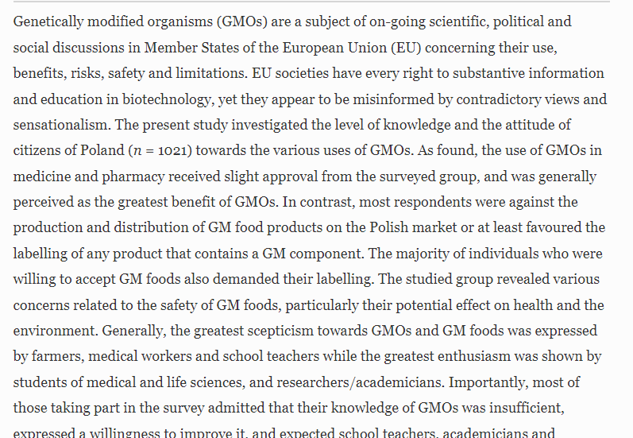
https://link.springer.com/article/10.1007/s12571-016-0572-z
| Appendix |

Slide 35
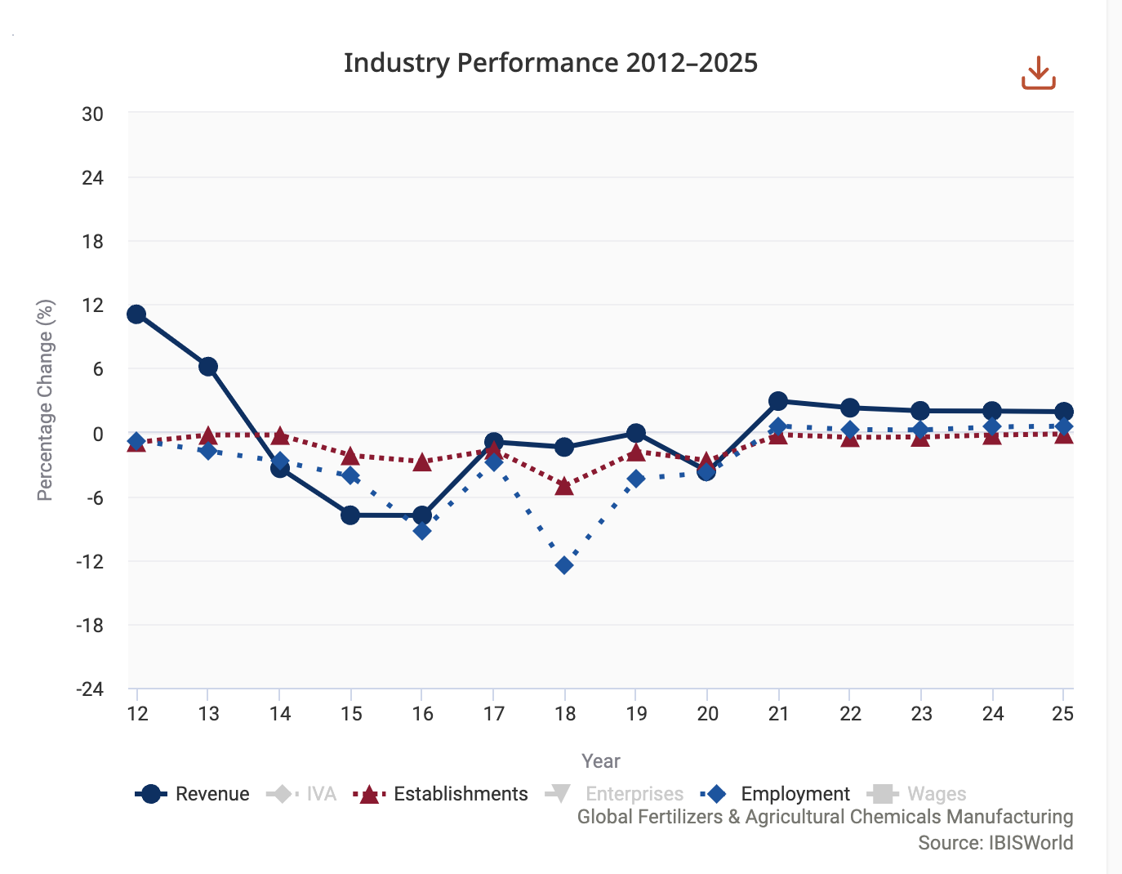
| Appendix |

Slide 36
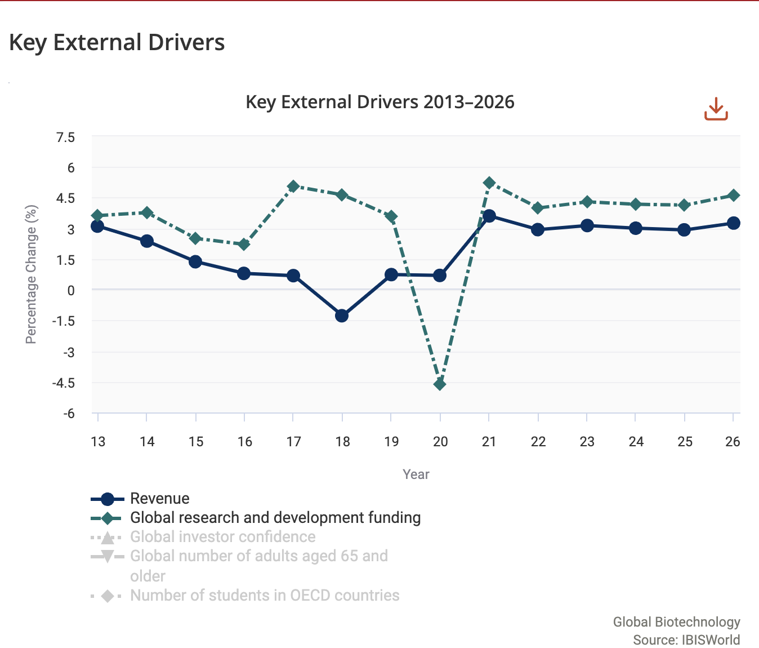
| Appendix |

Slide 37
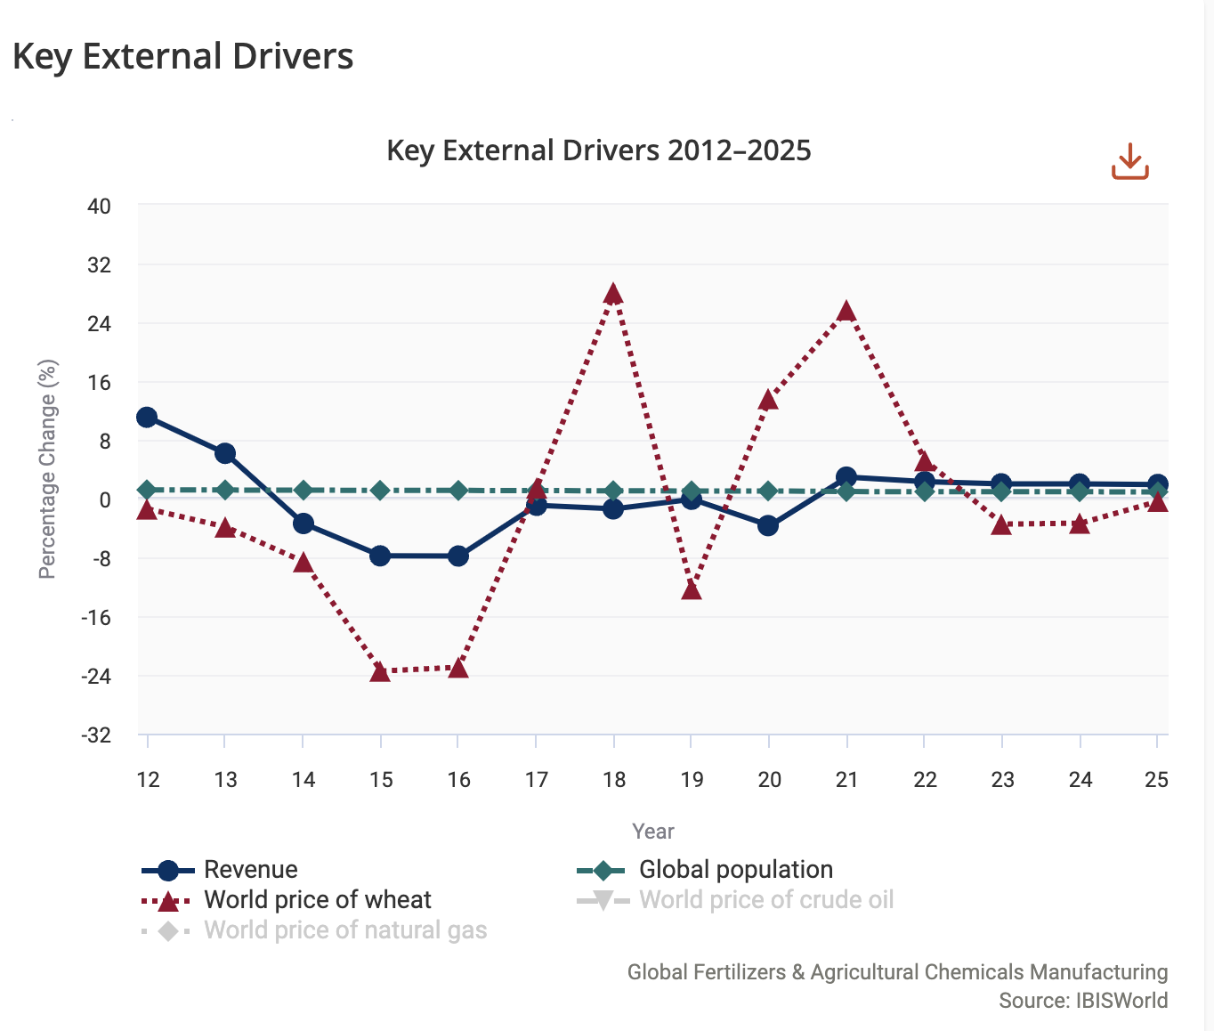
| Appendix |

Slide 38
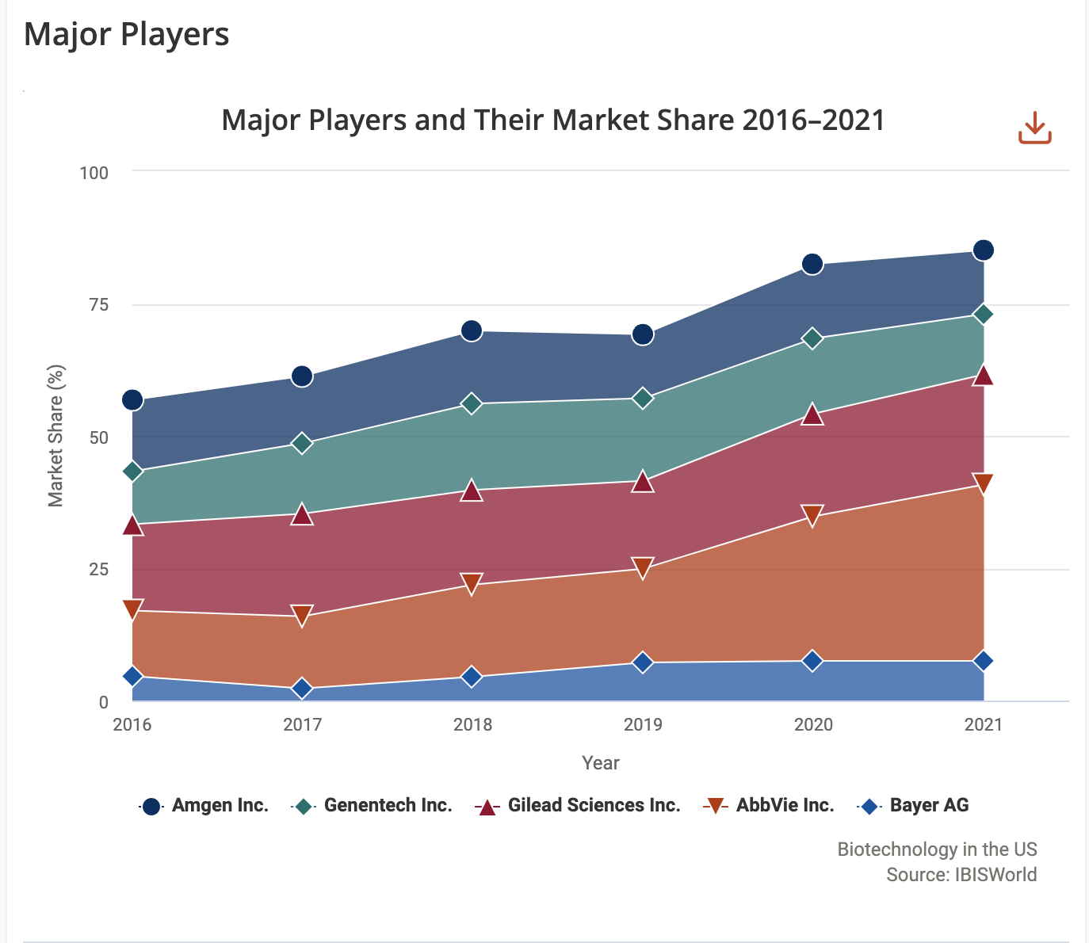
| Appendix |

Slide 39
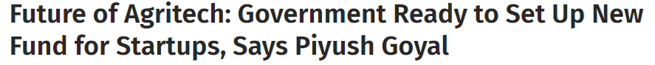
Future of Agritech: Government Ready to Set Up New Fund for Startups, Says Piyush Goyal (news18.com)
| Appendix |

Slide 40
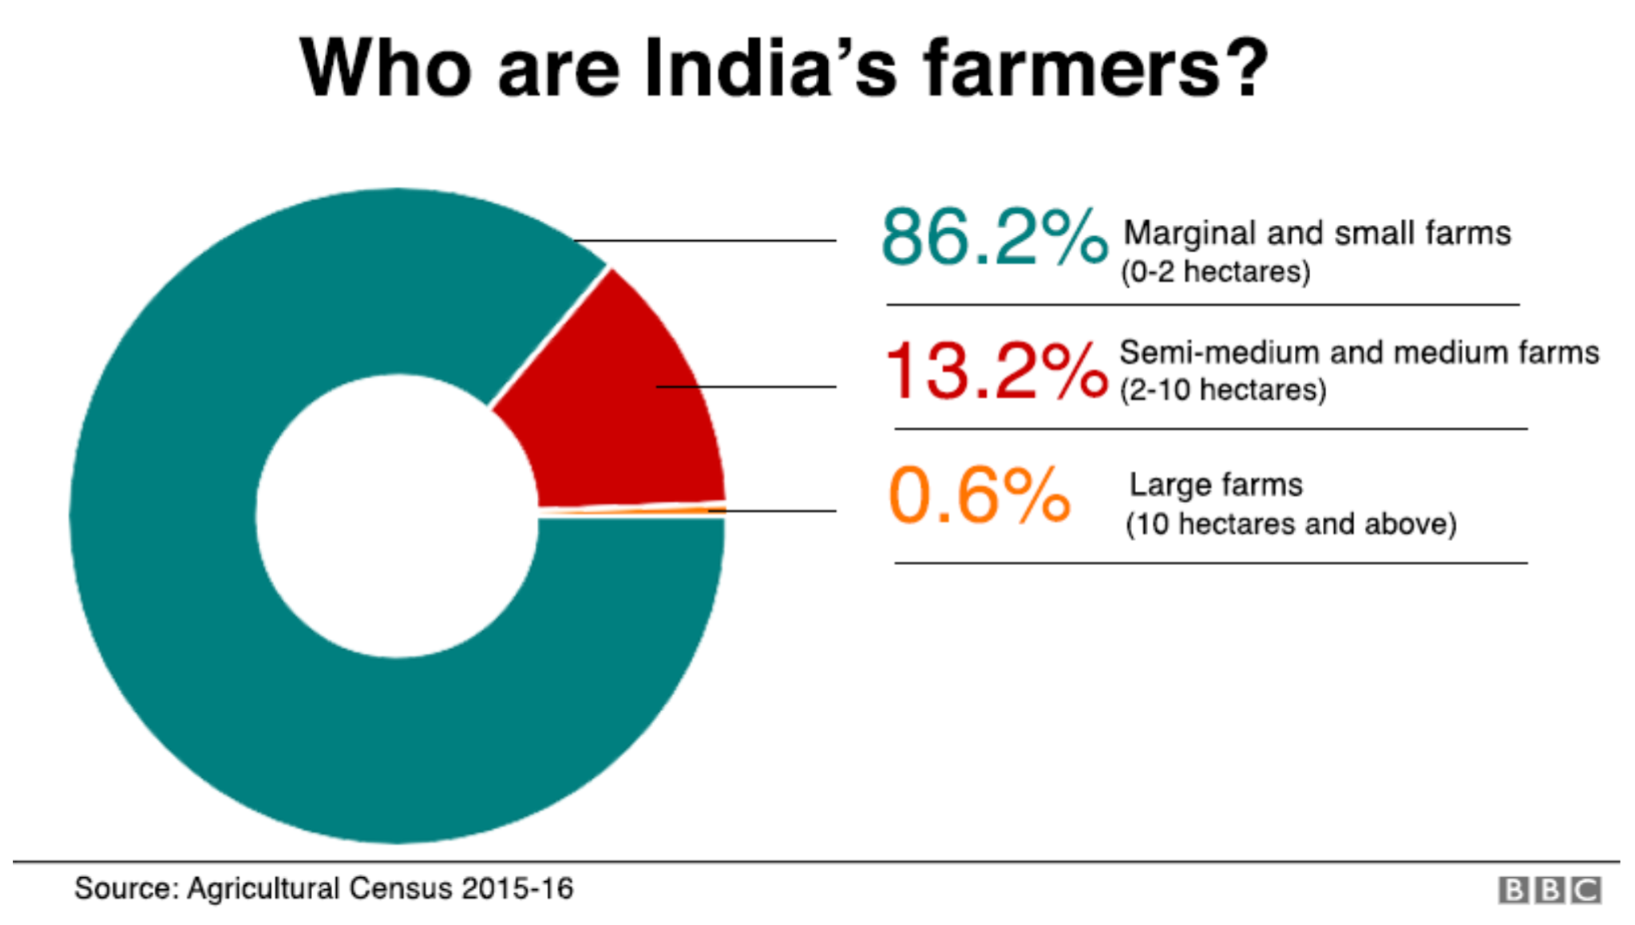
https://www.bbc.com/news/world-asia-india-46640789
| Appendix |

Slide 41
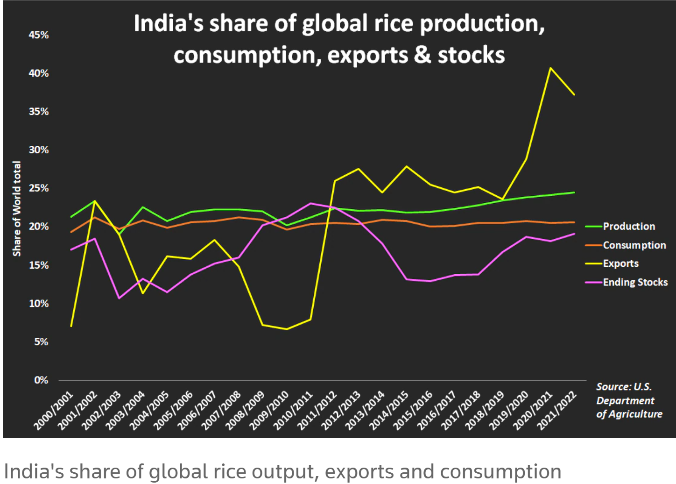
https://www.reuters.com/world/india/indias-record-rice-crop-brings-problem-plenty-farmers-juggling-protest-2021-10-26/
| Appendix |

Slide 42
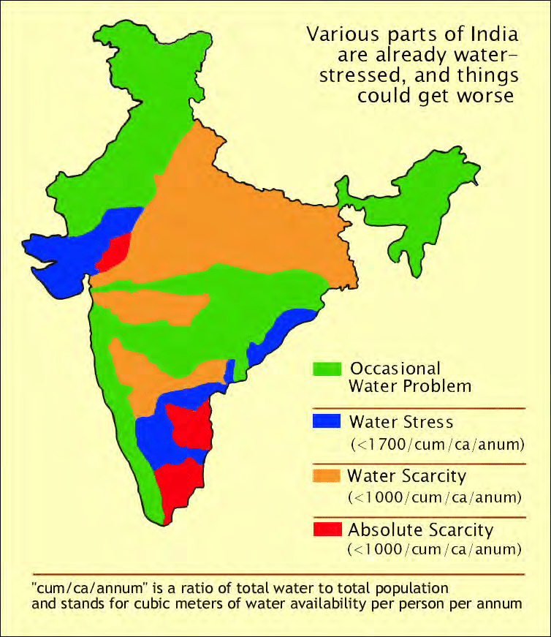

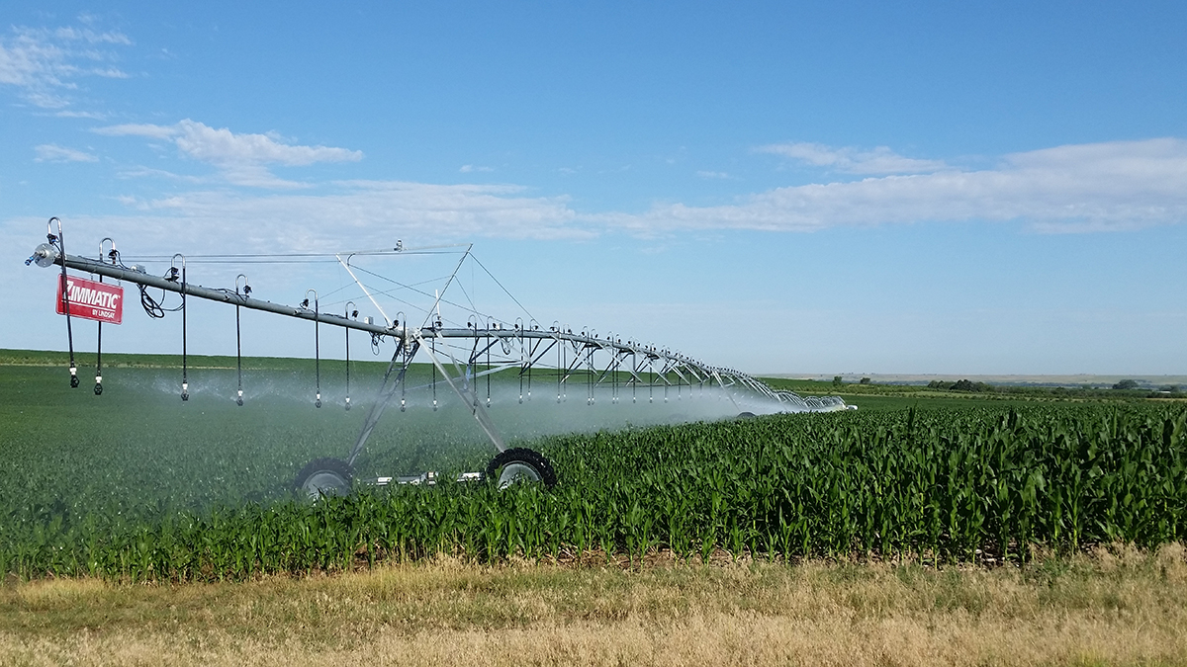
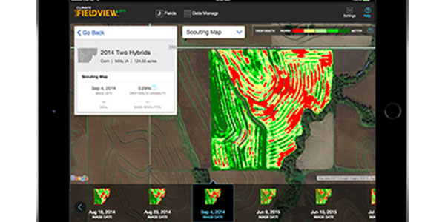
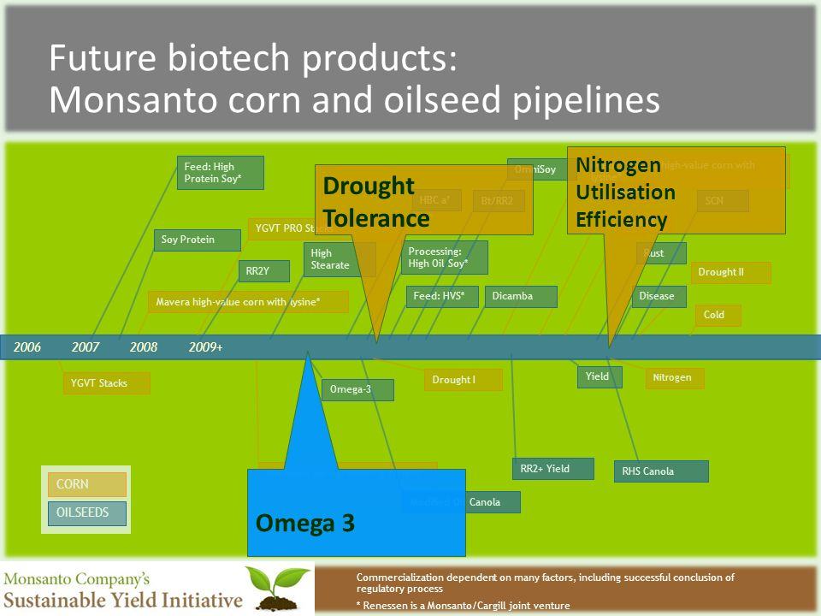
Monsanto Product and Local Benefits Demo
Full Scale Marketing Campaign
Posters
Local Tutorials
“Using GMO Farming methods, farmers can till a lot less — if they have to till at all — which is why they’re able to increase soil health, reduce erosion and cut herbicide runoff by 70 percent.”
Our development team will help:
Teach Generally Useful Info
Scarcity Maps
Demos for how to use Monsanto spreading tech
What’s the Best Kept Secret in Water Conservation? GMO Farming (afreshlook.org)
| Appendix |

Slide 43
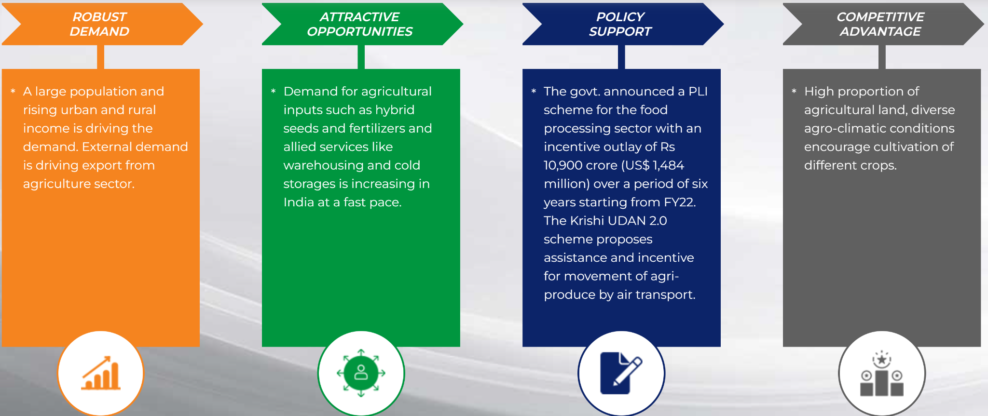
| Appendix |

Slide 44
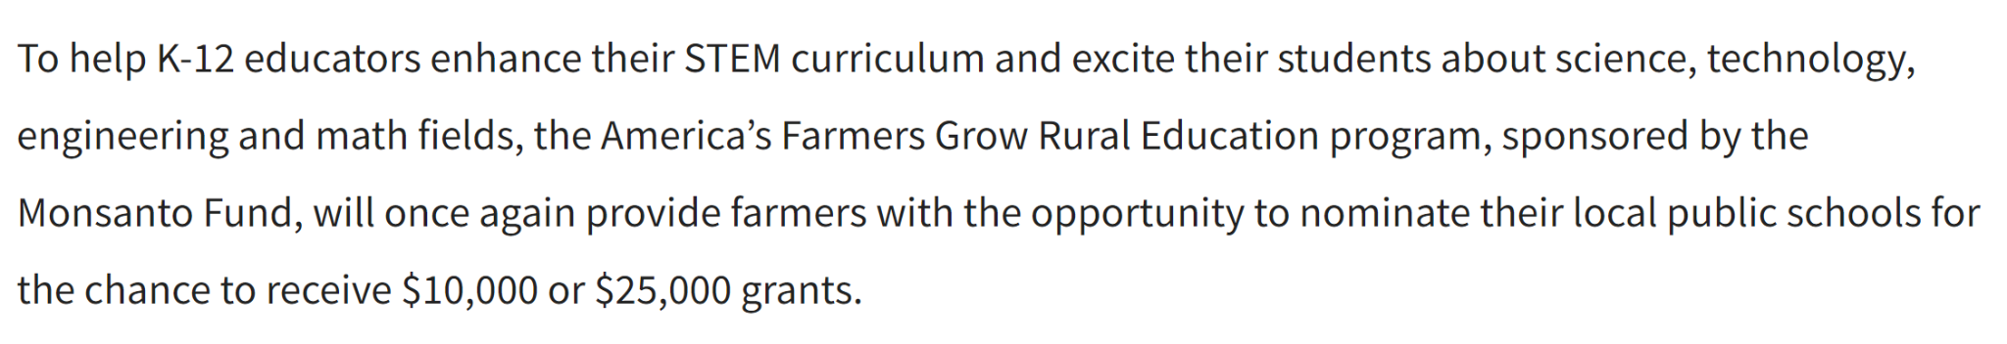
https://www.farmprogress.com/farm-life/apply-monsanto-fund-grant-enhance-stem-education
| Appendix |

Slide 45
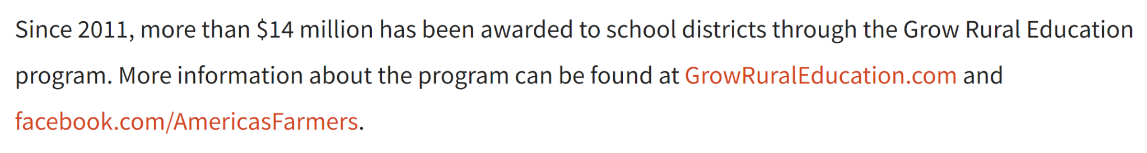
https://www.farmprogress.com/farm-life/apply-monsanto-fund-grant-enhance-stem-education
| Appendix |

Slide 46
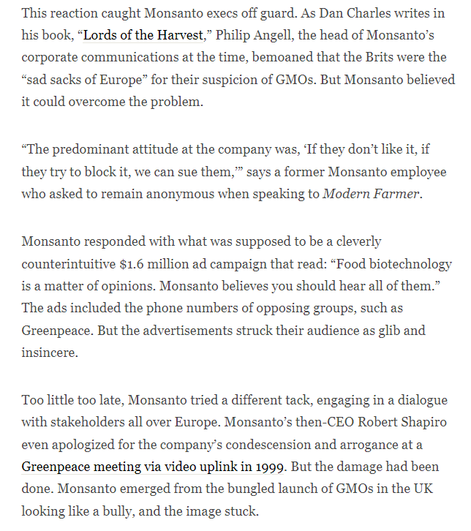
Monsanto’s feud with the European Union, specifically with the Royal family.
| Appendix |

Slide 47
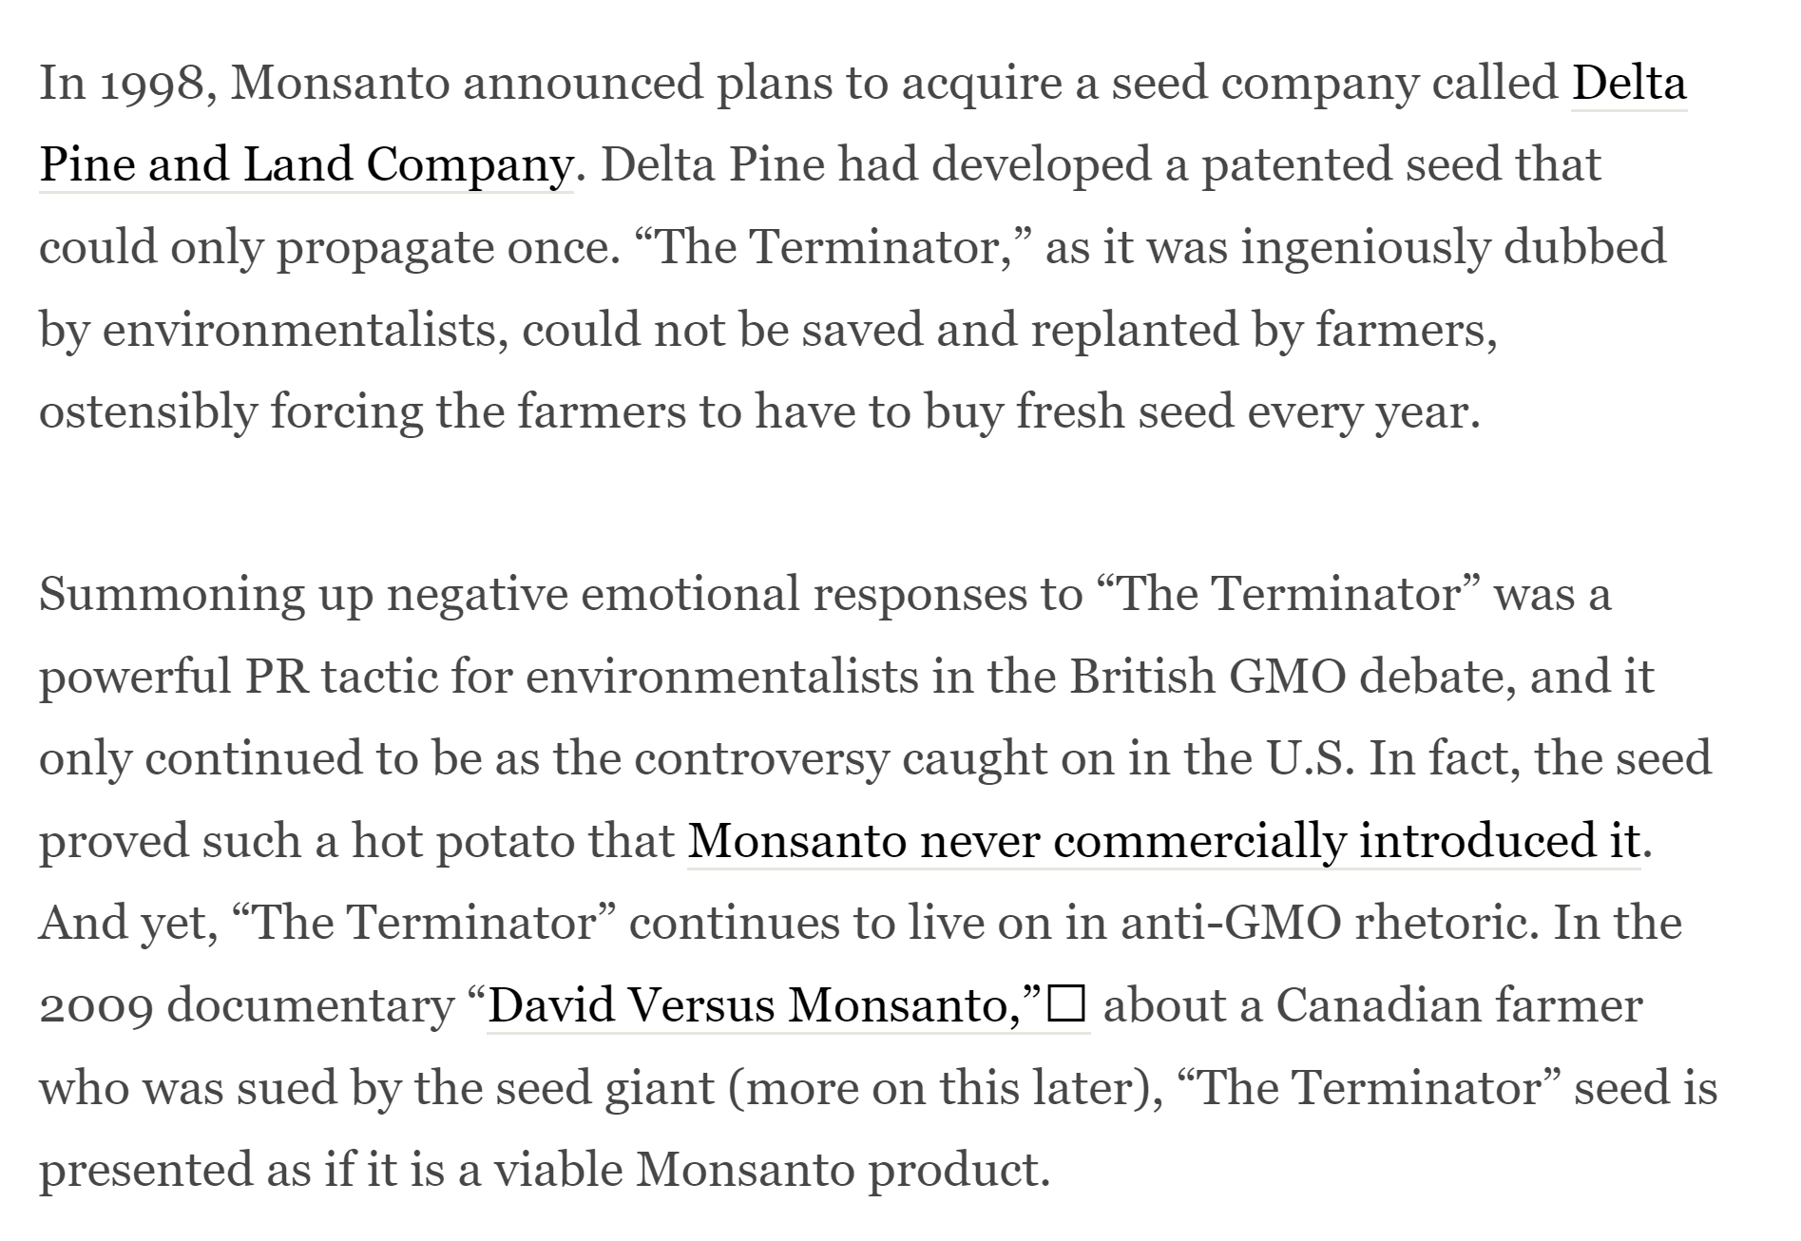
After purchasing Delta Pine, Monsanto was crucified for its involvement in the development of “The Terminator”, which the company had nothing to do with and refused to introduce it back to the markets.
| Appendix |

Slide 48
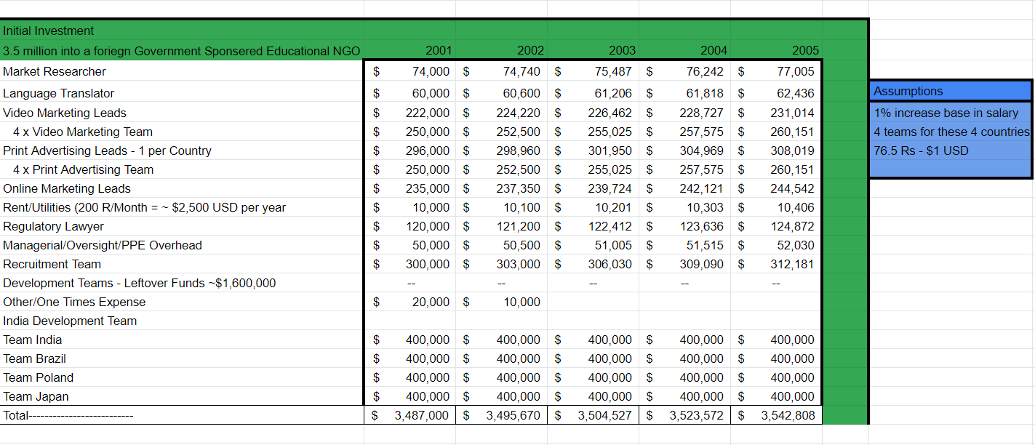
Marketing Budget
| Appendix |

Slide 49
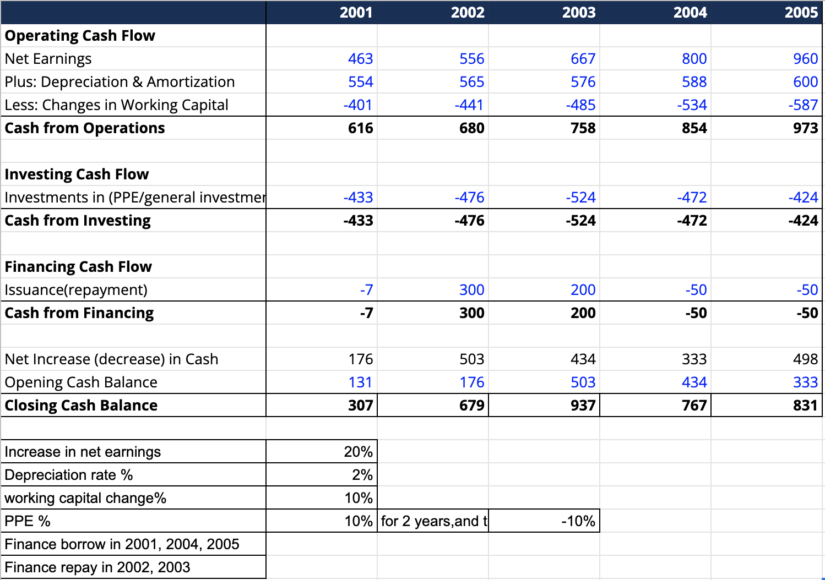
Statement of Cashflows
| Appendix |

Slide 50
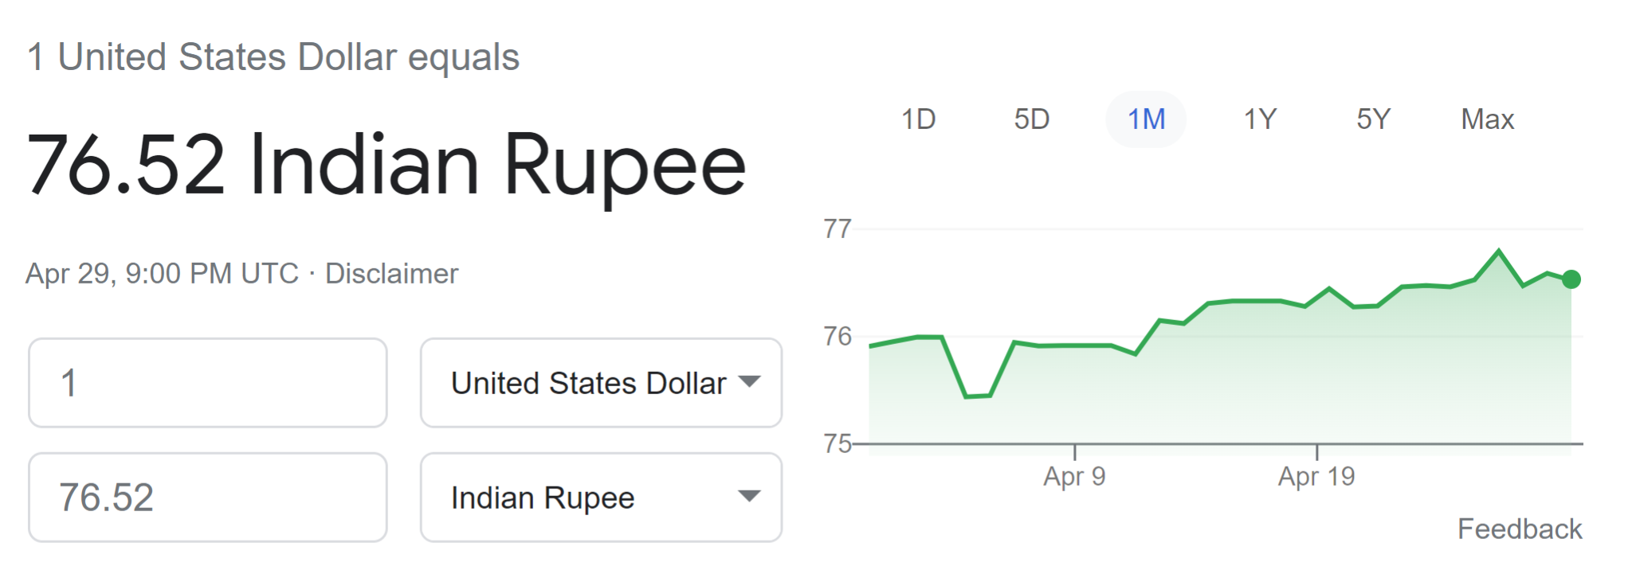
USD to Rupee
| Appendix |

Slide 51
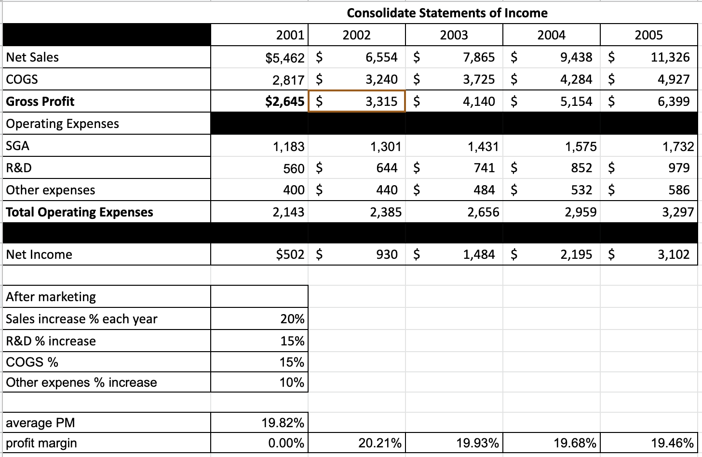
Income Statement
| Appendix |

